Slide 1
Welcome
Tamanna Alam Moon
Batch : 52 Roll: 01-052-02

Slide 2
Introduction::
A salary is a fixed amount of money that an employee receives regularly (typically on a monthly or bi-weekly basis) from an employer in exchange for the work or services they provide. Salaries are usually agreed upon in advance and are stated as an annual amount, though they are paid out in smaller instalments throughout the year.

Slide 3
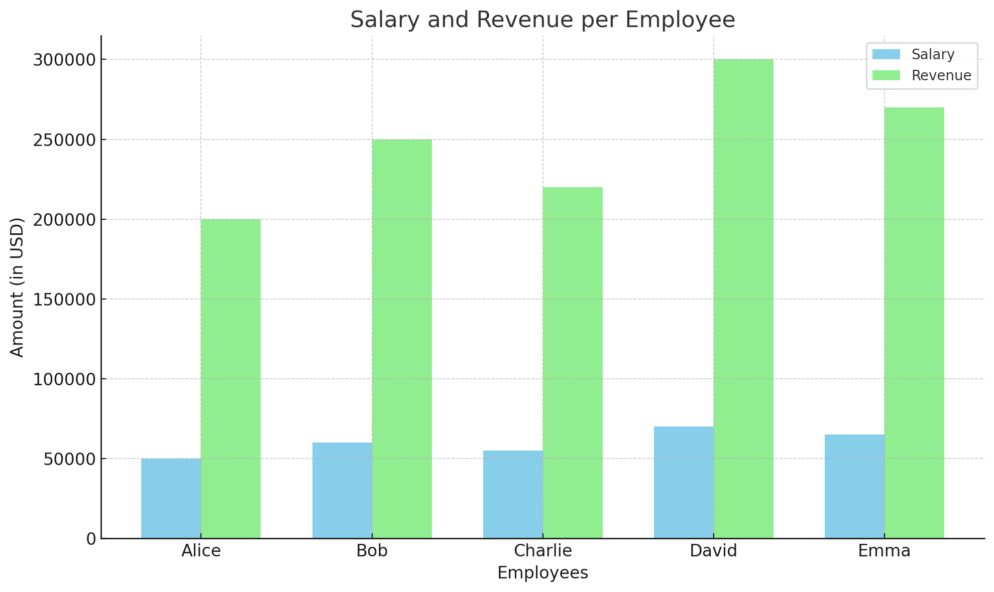

Slide 4
Here is the chart displaying the salaries and revenues for 5 employees. The chart demonstrates the financial relationship, showing how each employee's salary compares to the revenue they generate.

Slide 5
Thank you so much

